Slide 1
Storing Data: Disks and Files
SUN YAT-SEN UNIVERSITY

Slide 2
Block diagram of a DBMS
Query Optimization
and Execution
Relational Operators
Files and Access Methods
Concurrency
Control and
Recovery
Buffer Management
Disk Space Management
DB

Slide 3
Disks
DBMS stores information on disks.
Fixed unit of transfer
  Read/write disk blocks or pages (8K)
  磁盘块 页/数据页/磁盘页
Not “random access” (vs. RAM)
  Time to retrieve a block depends on location
  Relative placement of blocks on disk has major impact on DBMS performance!

Slide 4
Components of a Disk
Spindle
Disk head
Tracks
The platters spin (say, 120 rps).
The arm assembly is moved in or out to position a head on a desired track. Tracks under heads make a cylinder (imaginary!).
Sector
Arm movement
Platters
Only one head reads/writes at any one time.
Arm assembly
Block size is a multiple
of sector size (which is fixed).

Slide 5
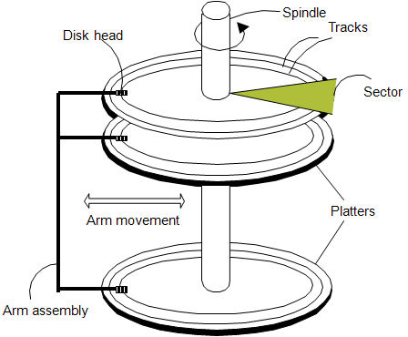
Accessing a Disk Page
Time to access (read/write -- 存取时间) a disk block:
  seek time (寻道时间-moving arms to position disk head on track)
  rotational delay (旋转延迟-waiting for block to rotate under head)
  transfer time (传输时间-actually moving data to/from disk surface)
Seek time and rotational delay dominate.
  Seek time varies from 0 to 10msec . – 平均时间
  Rotational delay varies from 0 to 3msec
  Transfer rate around 0.2msec per 8K block
Key to lower I/O cost: reduce seek/rotation delays! Hardware vs. software solutions?

Slide 6
Arranging Pages on Disk
`Next’ block concept:
  blocks on same track, followed by
  blocks on same cylinder, followed by
  blocks on adjacent cylinder
Blocks in a file should be arranged sequentially on disk (by `next’), to minimize seek and rotational delay.
  For a sequential scan, pre-fetching (预读取) several pages at a time is a big win!

Slide 7
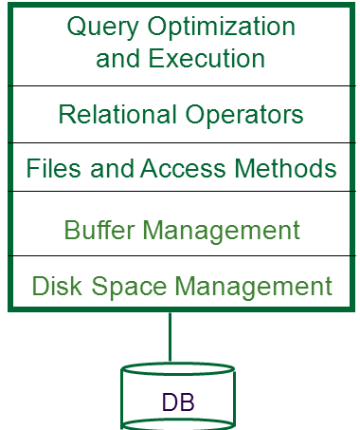
Disk Space Management
Lowest layer of DBMS, manages space on disk
接口: Higher levels call upon this layer to:
  allocate/de-allocate a page
  read/write a page
期望性能:Request for a sequence of pages best satisfied by pages stored sequentially on disk!
  Responsibility of disk space manager.
  Higher levels don’t know how this is done, or how free space is managed.
  They may make performance assumptions!
    Hence disk space manager should do a decent job.

Slide 8
Context
Query Optimization
and Execution
Relational Operators
Files and Access Methods
Buffer Management
Disk Space Management
DB

Slide 9
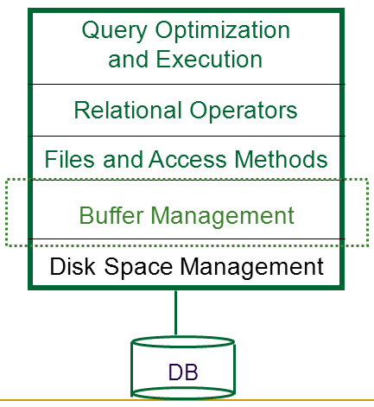
Buffer Management in a DBMS
缓冲区管理
Data must be in RAM for DBMS to operate on it!
BufMgr hides the fact that not all data is in RAM

Slide 10
Buffer Management in a DBMS
缓冲区管理—how?
Page Requests from Higher Levels
BUFFER POOL
A
X
copy of
disk page
free frame
C
MAIN MEMORY
DISK
choice of frame dictated
by replacement policy
DB
disk page
A
划分帧→（空闲帧/内容帧） → 副本→ 请求→替换策略

Slide 11
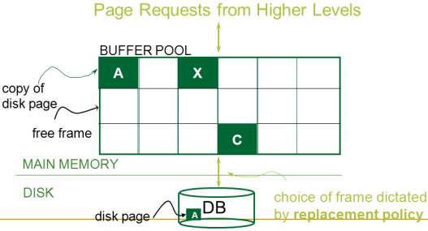
When a Page is Requested ...
Buffer pool information table contains: <frame#, pageid, pin_count, dirty>
If requested page is not in pool:
  Choose a frame for replacement.
  Only “un-pinned” pages are candidates!
  If frame “dirty”, write current page to disk
  Read requested page into frame
Pin the page and return its address.

Slide 12
More on Buffer Management
Requestor of page must eventually:
  unpin it -- 解钉 pin_count--
  indicate whether page was modified via dirty bit.
Page in pool may be requested many times,
  a pin _count is used.
  To pin a page(钉住页): pin_count++
  A page is a candidate for replacement iff
  pin_count == 0 (“unpinned”)
<frame#, pageid, pin_count, dirty>

Slide 13
Context
Query Optimization
and Execution
Relational Operators
Files and Access Methods
Buffer Management
Disk Space Management
DB

Slide 14
Files of Records (记录文件)
Blocks are the interface for I/O, but…
  Higher levels of DBMS operate on records, and files of records.
FILE: A collection of pages, each containing a collection of records. Must support:
  insert/delete/modify record
  fetch a particular record (specified using record id)
  scan all records (possibly with some conditions on the records to be retrieved)

Slide 15
Unordered (Heap) Files --堆文件
Collection of records in no particular order.
  As file shrinks/grows, disk pages (de)allocated
To support record level operations, we must:
  keep track of the pages in a file
  keep track of free space on pages
  keep track of the records on a page
There are many alternatives for keeping track of this.
  We’ll consider two.

Slide 16
Heap File Implemented as a List (页链表)
Data
Page
Data
Page
Data
Page
Full Pages
Header
Page
Data
Page
Data
Page
Data
Page
Pages with
Free Space
The header page(首页) id and Heap file name must be stored someplace.
  Database “catalog”
Each page contains 2 `pointers’ plus data.

Slide 17
Heap File Using a Page Directory(页目录)
Data
Page 1
Header
Page
Data
Page 2
Data
Page N
DIRECTORY
The directory is itself a collection of pages;
  each page can hold several entries.
  The entry (目录项) for a page can include the number of free bytes on the page. <pointer,free_number>
To insert a record, we can search the directory to determine which page has enough space to hold the record.

Slide 18
Record Formats(记录格式):
Fixed Length(定长记录)
F1
F2
F3
F4
L1
L2
L3
L4
Base address (B)
Address = B+L1+L2
Information about field types same for all records in a file; stored in system catalogs.
Finding i’th field done via arithmetic.

Slide 19
Record Formats:
Variable Length(变长记录)
Two alternative formats (# fields is fixed):
F1 F2 F3 F4
$
$
$
$
Fields Delimited by Special Symbols
F1 F2 F3 F4
Array of Field Offsets-字段偏移量数组
Second offers direct access to i’th field, efficient storage
of nulls (special don’t know value); small directory overhead.

Slide 20
Page Formats(页格式): Fixed Length Records
Slot 1
Slot 1
Slot 2
Slot 2
. . .
Free
Space
. . .
Slot N
Slot N
Slot M
N
1
. . .
0
1
1
M
number
of records
M ... 3 2 1
number
of slots
PACKED
UNPACKED, BITMAP
Record id = <page id, slot #>.
In first alternative,
  moving records for free space management changes rid;
  may not be acceptable.

Slide 21
Page Formats: Variable Length Records
slot’s format: <record offset, record length>
Rid = (i,N)
Page i
Rid = (i,2)
Data Area
Rid = (i,1)
Free Space
20
16
24
N
Pointer
to start
of free
space
N . . . 2 1
# slots
SLOT DIRECTORY(槽目录)
Can move records on page without changing rid; so, attractive for fixed-length records too.

Slide 22
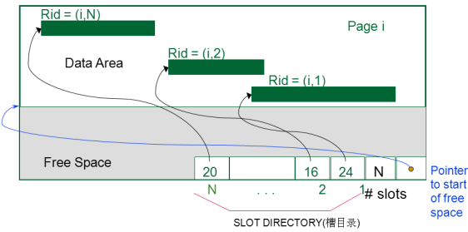
Slotted page: a detailed view
slot’s format: <record offset, record length>
# of slots
Pointer
to start
of free
space
Slot directory
 |  |  |  |  |  |  |  |  |  |  |  |  |  |  |  |  |  |  | 4 | 8 | 0 | 4 | 2 | 13
0 |  |  |  |  |  |  |  | 8 |  |  |  |  |  |  |  | 16 |  |  |  |  |  |  |  | 24

